Slide 1
MODULE-V
MODULE-V
Module 5 | RISK, QUALITY MANAGEMENT AND REENGINEERING | (09 Periods)
Risk and Quality Management: Reactive and Proactive risk strategies, Software risks, Risk Mitigation Monitoring and Management (RMMM), RMMM plan, Software quality factors, Defect Amplification Model, Formal Technical Reviews (FTR), Software Quality Assurance (SQA)-Tasks, Goals and Metrics; Software reliability. Reengineering: Introduction, Business Process Reengineering (BPR), Software Reengineering, Restructuring, Reverse engineering, Forward engineering.
Module 5 | RISK, QUALITY MANAGEMENT AND REENGINEERING | (09 Periods)
Risk and Quality Management: Reactive and Proactive risk strategies, Software risks, Risk Mitigation Monitoring and Management (RMMM), RMMM plan, Software quality factors, Defect Amplification Model, Formal Technical Reviews (FTR), Software Quality Assurance (SQA)-Tasks, Goals and Metrics; Software reliability. Reengineering: Introduction, Business Process Reengineering (BPR), Software Reengineering, Restructuring, Reverse engineering, Forward engineering.

Slide 2
RISK AND QUALITY MANAGEMENT
Risk Management is the system of identifying addressing and eliminating these problems before they can damage the project.
A software project can be concerned with a large variety of risks.
In order to be adept to systematically identify the significant risks which might affect a software project, it is essential to classify risks into different classes. The project manager can then check which risks from each class are relevant to the project.
There are three main classifications of risks which can affect a software project:
Project risks
Technical risks
Business risks

Slide 3
RISK AND QUALITY MANAGEMENT
Project risks: Project risks concern differ forms of budgetary, schedule, personnel, resource, and customer-related problems. Since the software is intangible, it is very tough to monitor and control a software project. It is very tough to control something which cannot be identified.
Technical risks: Technical risks concern potential method, implementation, interfacing, testing, and maintenance issue. It also consists of an ambiguous specification, incomplete specification, changing specification, technical uncertainty, and technical obsolescence. Most technical risks appear due to the development team's insufficient knowledge about the project.

Slide 4
RISK AND QUALITY MANAGEMENT
Business risks: This type of risks contain risks of building an excellent product that no one need, losing budgetary or personnel commitments, etc.
Principle of Risk Management
Global Perspective: In this, we review the bigger system description, design, and implementation.
Take a forward-looking view: Consider the threat which may appear in the future and create future plans for directing the next events.
Open Communication: This is to allow the free flow of communications between the client and the team members so that they have certainty about the risks.
Integrated management: In this method risk management is made an integral part of project management.
Continuous process: In this phase, the risks are tracked continuously throughout the risk management paradigm.

Slide 5
REACTIVE AND PROACTIVE RISK STRATEGIES
Root Cause Analysis (RCA) is one of the best methods to identify main cause or root cause of problems or events in very systematic way or process. RCA is based on the idea that for effective management, we need to find out way to prevent arising or occurring problems.
Each one needs to understand that if they want to solve or eliminate any problem, it is essential to go to the root cause of the problem and then eliminate problems so that they can reduce or control the reoccurrence of the problem.
For organizations that want to improve and grow continuously, it is very essential to identify the root cause although it is tough to do so, it is essential. RCA can also be used to modify or change core processes and issues in such way that prevents future problems.

Slide 6
REACTIVE AND PROACTIVE RISK STRATEGIES
Reactive and Proactive RCA :
The main question that arises is whether RCA is reactive or proactive? Some people think that RCA is only required to solve problems or failures that have already occurred.
1. Reactive RCA :
The main question that arises in reactive RCA is “What went wrong?”. Before investigating or identifying the root cause of failure or defect, failure needs to be in place or should be occurred already. One can only identify the root cause and perform the analysis only when problem or failure had occurred that causes malfunctioning in the system. Reactive RCA is a root cause analysis that is performed after the occurrence of failure or defect.

Slide 7
REACTIVE AND PROACTIVE RISK STRATEGIES
It is simply done to control, implemented to reduce the impact and severity of defect that has occurred. It is also known as reactive risk management. It reacts quickly as soon as problem occurs by simply treating symptoms. RCA is generally reactive but it has the potential to be proactive. RCA is reactive at initial and it can only be proactive if one addresses and identifies small things too that can cause problem as well as exposes hidden causes of the problem.
Advantages :
Helps one to prioritize tasks according to its severity and then resolve it.
Increases teamwork and their knowledge.
Disadvantages :
Sometimes, resolving equipment after failure can be more costly than preventing failure from an occurrence.
Failed equipment can cause greater damage to system and interrupts production activities.

Slide 8
REACTIVE AND PROACTIVE RISK STRATEGIES
2. Proactive RCA :
The main question that arises in proactive RCA is “What could go wrong?”. RCA can also be used proactively to mitigate failure or risk.
The main importance of RCA can be seen when it is applied to events that have not occurred yet. Proactive RCA is a root cause analysis that is performed before any occurrence of failure or defect.
It is simply done to control, implemented to prevent defect from its occurrence. As both reactive and proactive RCAs are is important, one should move from reactive to proactive RCA.

Slide 9
REACTIVE AND PROACTIVE RISK STRATEGIES
It is better to prevent issues from its occurrence rather than correcting it after its occurrence. In simple words, Prevention is better than correction.
Here, prevention action is considered as proactive and corrective action is considered as reactive. It is also known as proactive risk management.
It identifies the root cause of problem to eliminate it from reoccurring. With help of proactive RCA, we can identify the main root cause that leads to the occurrence of problem or failure, or defect. After knowing this, we can take various measures and implement actions to prevent these causes from the occurrence.

Slide 10
REACTIVE AND PROACTIVE RISK STRATEGIES
Advantages :
Future chances of failure occurrence can be minimized.
Reduce overall cost required to resolve failure by simply preventing failure from an occurrence.
Increases overall productivity by minimizing chances of interruption due to failure.
Disadvantages :
Sometimes, preventing equipment from failure can be more costly than resolving failure after occurrence.
Many resources and tools required to prevent failure from an occurrence that can affect the overall cost.
Requires highly skilled technicians to perform maintenance tasks.

Slide 11
SOFTWARE RISK
Software development is a multi stage approach of design, documentation, programming, prototyping, testing etc which follows a Software Development Life Cycle (SDLC) process. Different tasks are performed based on SDLC framework during software development. Developing and Maintaining software project involves risk in each step.
Most enterprises rely on software and ignoring the risks associated with any phase needs to be identified and managed/solved otherwise it creates unforeseen challenges for business. Before analyzing different risks involved in software development.

Slide 12
SOFTWARE RISK
Risk and importance of risk management :
Risk is uncertain events associated with future events which have a probability of occurrence but it may or may not occur and if occurs it brings loss to the project. Risk identification and management are very important task during software project development because success and failure of any software project depends on it.
Various Kinds of Risks in Software Development :
Schedule Risk :
Schedule related risks refers to time related risks or project delivery related planning risks. The wrong schedule affects the project development and delivery. These risks are mainly indicates to running behind time as a result project development doesn’t progress timely and it directly impacts to delivery of project. Finally if schedule risks are not managed properly it gives rise to project failure.

Slide 13
SOFTWARE RISK
Budget Risk :
Budget related risks refers to the monetary risks mainly it occurs due to budget overruns. Always the financial aspect for the project should be managed as per decided but if financial aspect of project mismanaged then there budget concerns will arise by giving rise to budget risks. So proper finance distribution and management are required for the success of project otherwise it may lead to project failure.
Operational Risks :
Operational risk refers to the procedural risks means these are the risks which happen in day-to-day operational activities during project development due to improper process implementation or some external operational risks.

Slide 14
SOFTWARE RISK
Technical Risks :
Technical risks refers to the functional risk or performance risk which means this technical risk mainly associated with functionality of product or performance part of the software product.
Programmatic Risks :
Programmatic risks refers to the external risk or other unavoidable risks. These are the external risks which are unavoidable in nature. These risks come from outside and it is out of control of programs.

Slide 15
RISK MITIGATION MONITORING AND MANAGEMENT (RMMM)
RMMM Plan
A risk management technique is usually seen in the software Project plan. This can be divided into Risk Mitigation, Monitoring, and Management Plan (RMMM). In this plan, all works are done as part of risk analysis. As part of the overall project plan project manager generally uses this RMMM plan.
In some software teams, risk is documented with the help of a Risk Information Sheet (RIS). This RIS is controlled by using a database system for easier management of information i.e creation, priority ordering, searching, and other analysis. After documentation of RMMM and start of a project, risk mitigation and monitoring steps will start.

Slide 16
RISK MITIGATION MONITORING AND MANAGEMENT (RMMM)
Risk Mitigation :
It is an activity used to avoid problems (Risk Avoidance).
Steps for mitigating the risks as follows.
Finding out the risk.
Removing causes that are the reason for risk creation.
Controlling the corresponding documents from time to time.
Conducting timely reviews to speed up the work.
Risk Monitoring :
It is an activity used for project tracking.
It has the following primary objectives as follows.

Slide 17
RISK MITIGATION MONITORING AND MANAGEMENT (RMMM)
Risk Management and planning :
It assumes that the mitigation activity failed and the risk is a reality. This task is done by Project manager when risk becomes reality and causes severe problems.
If the project manager effectively uses project mitigation to remove risks successfully then it is easier to manage the risks. This shows that the response that will be taken for each risk by a manager.
The main objective of the risk management plan is the risk register. This risk register describes and focuses on the predicted threats to a software project.

Slide 18
RISK MITIGATION MONITORING AND MANAGEMENT (RMMM)
Risk Mitigation:
To mitigate this risk, project management must develop a strategy for reducing turnover. The possible steps to be taken are:
Meet the current staff to determine causes for turnover (e.g., poor working conditions, low pay, competitive job market).
Mitigate those causes that are under our control before the project starts.
Once the project commences, assume turnover will occur and develop techniques to ensure continuity when people leave.
Organize project teams so that information about each development activity is widely dispersed.
Define documentation standards and establish mechanisms to ensure that documents are developed in a timely manner.
Assign a backup staff member for every critical technologist.

Slide 19
RISK MITIGATION MONITORING AND MANAGEMENT (RMMM)
Risk Monitoring:
As the project proceeds, risk monitoring activities commence. The project manager monitors factors that may provide an indication of whether the risk is becoming more or less likely. In the case of high staff turnover, the following factors can be monitored:
General attitude of team members based on project pressures.
Interpersonal relationships among team members.
Potential problems with compensation and benefits.
The availability of jobs within the company and outside it.

Slide 20
RISK MITIGATION MONITORING AND MANAGEMENT (RMMM)
Risk Management:
Risk management and contingency planning assumes that mitigation efforts have failed and that the risk has become a reality. If the mitigation strategy has been followed, backup is available, information is documented, and knowledge has been dispersed across the team. In addition, the project manager may temporarily refocus resources to those functions that are fully staffed, enabling newcomers who must be added to the team to “get up to the speed“.
Drawbacks of RMMM:
It incurs additional project costs.
It takes additional time.
RMMM does not guarantee a risk-free project, infact, risks may also come up after the project is delivered.

Slide 21
SOFTWARE QUALITY FACTORS
The various factors, which influence the software, are termed as software factors. They can be broadly divided into two categories. The first category of the factors is of those that can be measured directly such as the number of logical errors, and the second category clubs those factors which can be measured only indirectly.
Several models of software quality factors and their categorization have been suggested over the years. The classic model of software quality factors, suggested by McCall, consists of 11 factors (McCall et al., 1977). Similarly, models consisting of 12 to 15 factors, were suggested by Deutsch and Willis (1988) and by Evans and Marciniak (1987).
All these models do not differ substantially from McCall’s model. The McCall factor model provides a practical, up-to-date method for classifying software requirements (Pressman, 2000).

Slide 22
SOFTWARE QUALITY FACTORS
McCall’s Factor Model
This model classifies all software requirements into 11 software quality factors. The 11 factors are grouped into three categories – product operation, product revision, and product transition factors.
Product operation factors − Correctness, Reliability, Efficiency, Integrity, Usability.
Product revision factors − Maintainability, Flexibility, Testability.
Product transition factors − Portability, Reusability, Interoperability.

Slide 23
SOFTWARE QUALITY FACTORS
Product Operation Software Quality Factors
According to McCall’s model, product operation category includes five software quality factors, which deal with the requirements that directly affect the daily operation of the software.
Correctness
These requirements deal with the correctness of the output of the software system.
Output mission
The required accuracy of output that can be negatively affected by inaccurate data or inaccurate calculations.
The completeness of the output information, which can be affected by incomplete data.
The up-to-date of the information defined as the time between the event and the response by the software system.

Slide 24
SOFTWARE QUALITY FACTORS
Reliability
Reliability requirements deal with service failure. They determine the maximum allowed failure rate of the software system, and can refer to the entire system or to one or more of its separate functions.
Efficiency
It deals with the hardware resources needed to perform the different functions of the software system.
It also deals with the time between recharging of the system’s portable units, such as, information system units located in portable computers, or meteorological units placed outdoors.
Integrity
This factor deals with the software system security, that is, to prevent access to unauthorized persons, also to distinguish between the group of people to be given read as well as write permit.

Slide 25
SOFTWARE QUALITY FACTORS
Product Revision Quality Factors
According to McCall’s model, three software quality factors are included in the product revision category.
Maintainability
This factor considers the efforts that will be needed by users and maintenance personnel to identify the reasons for software failures, to correct the failures, and to verify the success of the corrections.
Flexibility
This factor deals with the capabilities and efforts required to support adaptive maintenance activities of the software. These include adapting the current software to additional circumstances and customers without changing the software.

Slide 26
SOFTWARE QUALITY FACTORS
Product Transition Software Quality Factor
According to McCall’s model, three software quality factors are included in the product transition category that deals with the adaptation of software to other environments and its interaction with other software systems.
Portability
Portability requirements tend to the adaptation of a software system to other environments consisting of different hardware, different operating systems, and so forth.
Reusability
This factor deals with the use of software modules originally designed for one project in a new software project currently being developed. They may also enable future projects to make use of a given module or a group of modules of the currently developed software.

Slide 27
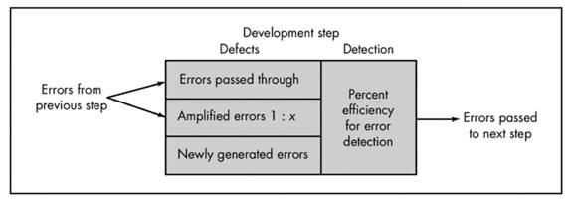
DEFECT AMPLIFICATION MODEL

Slide 28
DEFECT AMPLIFICATION MODEL
A box represents a software development step.
During the step, errors may be inadvertently generated.
Review may fail to uncover newly generated errors and errors from previous steps, resulting in some number of errors that are passed through.
In some cases, errors passed through from previous steps are amplified (amplification factor, x) by current work.
box subdivisions represent each of these characteristics and the percent of efficiency for detecting errors, a function of the thoroughness of the review.

Slide 29
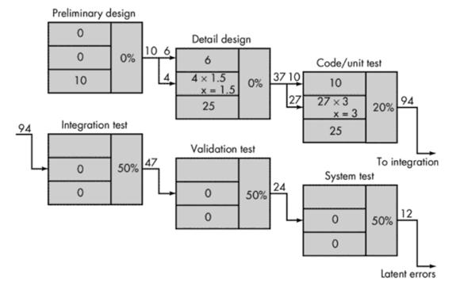
DEFECT AMPLIFICATION MODEL

Slide 30
DEFECT AMPLIFICATION MODEL
Hypothetical example of defect amplification for a software development process in which no reviews are conducted.
Each test step uncovers and corrects 50 percent of all incoming errors without introducing any new errors.
Ten preliminary design defects are amplified to 94 errors before testing commences.
Twelve latent errors are released to the field.

Slide 31
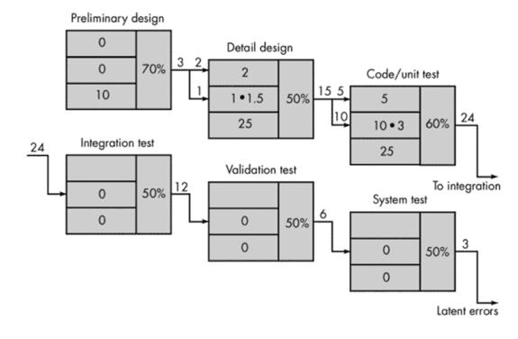
DEFECT AMPLIFICATION MODEL

Slide 32
DEFECT AMPLIFICATION MODEL
Same conditions except that design and code reviews are conducted as part of each development step.
Ten initial preliminary design errors are amplified to 24 errors before testing commences.
Only three latent errors exist.

Slide 33
FORMAL TECHNICAL REVIEWS (FTR)
Objectives of the FTR –
To uncover errors in function, logic, or implementation for any representation of the software
To verify that the software under review meets its requirements
To ensure that the software has been represented according to predefined standards
To achieve software that is developed in a uniform manner;
To make projects more manageable.

Slide 34
FORMAL TECHNICAL REVIEWS (FTR)
Walkthroughs are conducted for each component or small group of components.
FTR focuses on a work product (e.g., a portion of a requirements specification, a detailed component design, a source code listing for a component).
Individual who has developed the work product informs the project leader that the work product is complete and that a review is required.
The project leader contacts a review leader, who evaluates the product for readiness, generates copies of product materials, and distributes them to two or three reviewers for advance preparation.

Slide 35
FORMAL TECHNICAL REVIEWS (FTR)
Each reviewer is expected to spend between one and two hours reviewing the product, making notes, and otherwise becoming familiar with the work. Concurrently, the review leader also reviews the product and establishes an agenda for the review meeting, which is typically scheduled for the next day.
Review meeting attended by
review leader
all reviewers
the producer.
One reviewer takes on the role of the recorder; that is, the individual who records (in writing) all important issues raised during the review.

Slide 36
SOFTWARE QUALITY ASSURANCE (SQA)
Software Quality Assurance (SQA) is simply a way to assure quality in the software.
It is the set of activities which ensure processes, procedures as well as standards are suitable for the project and implemented correctly.
Software Quality Assurance is a process which works parallel to development of software.
It focuses on improving the process of development of software so that problems can be prevented before they become a major issue. Software Quality Assurance is a kind of Umbrella activity that is applied throughout the software process.

Slide 37
SOFTWARE QUALITY ASSURANCE (SQA)
Software Quality Assurance has:
A quality management approach
Formal technical reviews
Multi testing strategy
Effective software engineering technology
Measurement and reporting mechanism
Major Software Quality Assurance Activities:
SQA Management Plan:
Make a plan for how you will carry out the sqathrough out the project. Think about which set of software engineering activities are the best for project. check level of sqa team skills.

Slide 38
SOFTWARE QUALITY ASSURANCE (SQA)
Set The Check Points:
SQA team should set checkpoints. Evaluate the performance of the project on the basis of collected data on different check points.
Multi testing Strategy:
Do not depend on a single testing approach. When you have a lot of testing approaches available use them.
Measure Change Impact:
The changes for making the correction of an error sometimes re introduces more errors keep the measure of impact of change on project. Reset the new change to change check the compatibility of this fix with whole project.

Slide 39
SOFTWARE QUALITY ASSURANCE (SQA)
Benefits of Software Quality Assurance (SQA):
SQA produces high quality software.
High quality application saves time and cost.
SQA is beneficial for better reliability.
SQA is beneficial in the condition of no maintenance for a long time.
High quality commercial software increase market share of company.
Improving the process of creating software.
Improves the quality of the software.
Disadvantage of SQA:
There are a number of disadvantages of quality assurance. Some of them include adding more resources, employing more workers to help maintain quality and so much more.

Slide 40
SOFTWARE RELIABILITY
Software Reliability means Operational reliability. It is described as the ability of a system or component to perform its required functions under static conditions for a specific period.
Software reliability is also defined as the probability that a software system fulfills its assigned task in a given environment for a predefined number of input cases, assuming that the hardware and the input are free of error.
Software Reliability is an essential connect of software quality, composed with functionality, usability, performance, serviceability, capability, installability, maintainability, and documentation.
While any system with a high degree of complexity, containing software, will be hard to reach a certain level of reliability, system developers tend to push complexity into the software layer, with the speedy growth of system size and ease of doing so by upgrading the software.

Slide 41
REENGINEERING
Software Re-engineering is a process of software development which is done to improve the maintainability of a software system. Re-engineering is the examination and alteration of a system to reconstitute it in a new form. This process encompasses a combination of sub-processes like reverse engineering, forward engineering, reconstructing etc.
Re-engineering is the reorganizing and modifying existing software systems to make them more maintainable.
Objectives of Re-engineering:
To describe a cost-effective option for system evolution.
To describe the activities involved in the software maintenance process.
To distinguish between software and data re-engineering and to explain the problems of data re-engineering.

Slide 42
REENGINEERING
Steps involved in Re-engineering:
Inventory Analysis
Document Reconstruction
Reverse Engineering
Code Reconstruction
Data Reconstruction
Forward Engineering

Slide 43
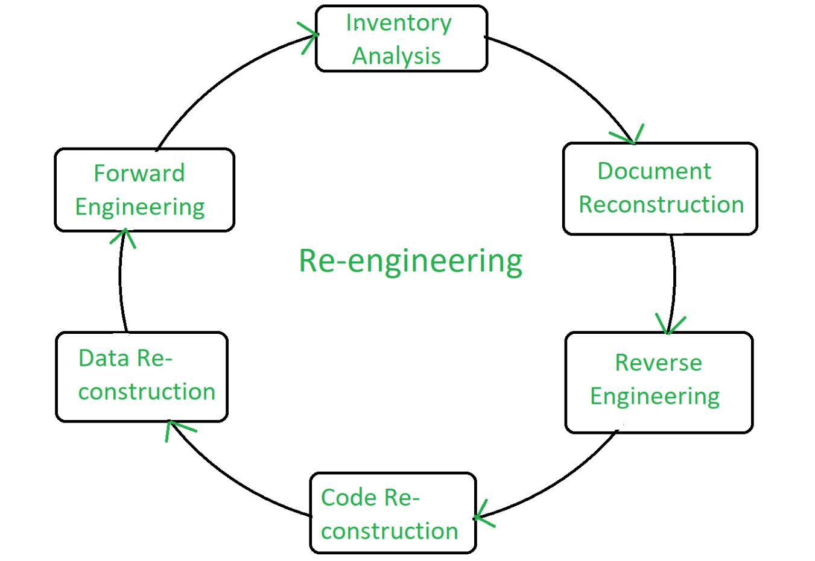
REENGINEERING

Slide 44
REENGINEERING
Re-engineering Cost Factors:
The quality of the software to be re-engineered
The tool support available for re-engineering
The extent of the required data conversion
The availability of expert staff for re-engineering
Advantages of Re-engineering:
Reduced Risk: As the software is already existing, the risk is less as compared to new software development. Development problems, staffing problems and specification problems are the lots of problems which may arise in new software development.
Reduced Cost: The cost of re-engineering is less than the costs of developing new software.
Revelation of Business Rules: As a system is re-engineered , business rules that are embedded in the system are rediscovered.

Slide 45
REENGINEERING
Disadvantages of Re-engineering:
Practical limits to the extent of re-engineering.
Major architectural changes or radical reorganizing of the systems data management has to be done manually.
Re-engineered system is not likely to be as maintainable as a new system developed using modern software Re-engineering methods.

Slide 46
BUSINESS PROCESS REENGINEERING (BPR)
Business process re-engineering is not just a change, but actually it is a dramatic change and dramatic improvements.
This is only achieved through overhaul the organization structures, job descriptions, performance management, training and the most importantly, the use of IT i.e. Information Technology.
BPR projects have failed sometimes to meet high expectations. Many unsuccessful BPR attempts are due to the confusion surrounding BPR and how it should be performed.
It becomes the process of trial and error.

Slide 47
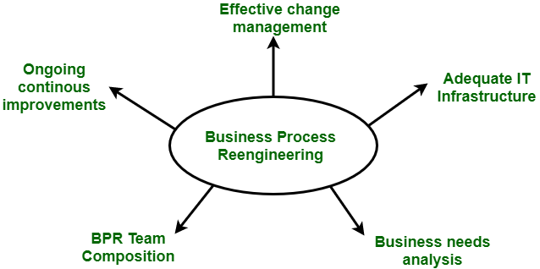
BUSINESS PROCESS REENGINEERING (BPR)

Slide 48
BUSINESS PROCESS REENGINEERING (BPR)
Phases of BPR :
According to Peter F. Drucker, ” Re-engineering is new, and it has to be done.” There are 7 different phases for BPR. All the projects for BPR begin with the most critical requirement i.e. communication throughout the organization.
Begin organizational change.
Build the re-engineering organization.
Identify BPR opportunities.
Understand the existing process.
Reengineer the process
Blueprint the new business system.
Perform the transformation.

Slide 49
BUSINESS PROCESS REENGINEERING (BPR)
Objectives of BPR :
Following are the objectives of the BPR :
To dramatically reduce cost.
To reduce time requirements.
To improve customer services dramatically.
To reinvent the basic rules of the business e.g. The airline industry.
Customer satisfaction.
Organizational learning.

Slide 50
BUSINESS PROCESS REENGINEERING (BPR)
Challenges faced by BPR process :
All the BPR processes are not as successful as described. The companies that have start the use of BPR projects face many of the following challenges :
Resistance
Tradition
Time requirements
Cost
Job losses

Slide 51
BUSINESS PROCESS REENGINEERING (BPR)
Advantages of BPR :
BPR offers tight integration among different modules.
It offers same views for the business i.e. same database, consistent reporting and analysis.
It offers process orientation facility i.e. streamline processes.
It offers rich functionality like templates and reference models.
It is flexible.
It is scalable.
It is expandable.
Disadvantages of BPR :
Following are the Disadvantages of BPR :
It depends on various factors like size and availability of resources. So, it will not fit for every business.

Slide 52
SOFTWARE REENGINEERING
Software Re-Engineering is the examination and alteration of a system to reconstitute it in a new form. The principles of Re-Engineering when applied to the software development process is called software re-engineering.
It affects positively at software cost, quality, service to the customer and speed of delivery. In Software Re-engineering, we are improving the software to make it more efficient and effective.
The need of software Re-engineering:
Software re-engineering is an economical process for software development and quality enhancement of the product. This process enables us to identify the useless consumption of deployed resources and the constraints that are restricting the development process so that the development process could be made easier and cost-effective and maintainable.

Slide 53
SOFTWARE REENGINEERING
The software reengineering is necessary for having-
a) Boost up productivity: Software reengineering increase productivity by optimizing the code and database so that processing gets faster.
b) Processes in continuity: The functionality of older software product can be still used while the testing or development of software.
c) Improvement opportunity: Meanwhile the process of software reengineering, not only software qualities, features and functionality but also your skills are refined, new ideas hit in your mind. This makes the developers mind accustomed to capturing new opportunities so that more and more new features can be developed.

Slide 54
SOFTWARE REENGINEERING
d) Reduction in risks: Instead of developing the software product from scratch or from the beginning stage here developers develop the product from its existing stage to enhance some specific features that are brought in concern by stakeholders or its users. Such kind of practice reduces the chances of fault fallibility.
e) Saves time: As we stated above here that the product is developed from the existing stage rather than the beginning stage so the time consumes in software engineering is lesser.
f) Optimization: This process refines the system features, functionalities and reduces the complexity of the product by consistent optimization as maximum as possible.

Slide 55
SOFTWARE REENGINEERING
Software Re-Engineering Activities:
1. Inventory Analysis:
Every software organisation should have an inventory of all the applications.
Inventory can be nothing more than a spreadsheet model containing information that provides a detailed description of every active application.
By sorting this information according to business criticality, longevity, current maintainability and other local important criteria, candidates for re-engineering appear.
The resource can then be allocated to a candidate application for re-engineering work.

Slide 56
SOFTWARE REENGINEERING
2. Document reconstructing:
Documentation of a system either explains how it operates or how to use it.
Documentation must be updated.
It may not be necessary to fully document an application.
The system is business-critical and must be fully re-documented.
3. Reverse Engineering:
Reverse engineering is a process of design recovery. Reverse engineering tools extract data, architectural and procedural design information from an existing program.

Slide 57
SOFTWARE REENGINEERING
4. Code Reconstructing:
To accomplish code reconstructing, the source code is analysed using a reconstructing tool. Violations of structured programming construct are noted and code is then reconstructed.
The resultant restructured code is reviewed and tested to ensure that no anomalies have been introduced.
5. Data Restructuring:
Data restructuring begins with a reverse engineering activity.
Current data architecture is dissected, and the necessary data models are defined.
Data objects and attributes are identified, and existing data structure are reviewed for quality.

Slide 58
SOFTWARE REENGINEERING
6. Forward Engineering:
Forward Engineering also called as renovation or reclamation not only for recovers design information from existing software but uses this information to alter or reconstitute the existing system in an effort to improve its overall quality.

Slide 59
RESTRUCTURING
Software restructuring modifies source code and/or data in an effort to make it amenable to future changes. In general, restructuring does not modify the overall program architecture.
It tends to focus on the design details of individual modules and on local data structures defined within modules. If the restructuring effort extends beyond module boundaries and encompasses the software architecture, restructuring becomes forward engineering .
Restructuring occurs when the basic architecture of an application is solid, even though technical internals need work.
It is initiated when major parts of the software are serviceable and only a subset of all modules and data need extensive modification.

Slide 60
RESTRUCTURING
Code Restructuring
Code restructuring is performed to yield a design that produces the same function but with higher quality than the original program. In general, code restructuring techniques model program logic using Boolean algebra and then apply a series of transformation rules that yield restructured logic.
Data Restructuring
Before data restructuring can begin, a reverse engineering activity called analysis of source code must be conducted. All programming language statements that contain data definitions, file descriptions, I/O, and interface descriptions are evaluated. The intent is to extract data items and objects, to get information on data flow, and to understand the existing data structures that have been implemented. This activity is sometimes called data analysis .

Slide 61
REVERSE ENGINEERING
Software Reverse Engineering is a process of recovering the design, requirement specifications and functions of a product from an analysis of its code. It builds a program database and generates information from this.
The purpose of reverse engineering is to facilitate the maintenance work by improving the understandability of a system and to produce the necessary documents for a legacy system.
Reverse Engineering Goals:
Cope with Complexity.
Recover lost information.
Detect side effects.
Facilitate Reuse.

Slide 62
REVERSE ENGINEERING
Steps of Software Reverse Engineering:
Collection Information:
This step focuses on collecting all possible information (i.e., source design documents etc.) about the software.
Examining the information:
The information collected in step-1 as studied so as to get familiar with the system.
Extracting the structure:
This step concerns with identification of program structure in the form of structure chart where each node corresponds to some routine.
Recording the functionality:
During this step processing details of each module of the structure, charts are recorded using structured language like decision table, etc.

Slide 63
REVERSE ENGINEERING
Recording data flow:
From the information extracted in step-3 and step-4, set of data flow diagrams are derived to show the flow of data among the processes.
Recording control flow:
High level control structure of the software is recorded.
Review extracted design:
Design document extracted is reviewed several times to ensure consistency and correctness. It also ensures that the design represents the program.
Generate documentation:
Finally, in this step, the complete documentation including SRS, design document, history, overview, etc. are recorded for future use.

Slide 64
FORWARD ENGINEERING
Forward engineering is the process of building from a high-level model or concept to build in complexities and lower-level details.
This type of engineering has different principles in various software and database processes.
Generally, forward engineering is important in IT because it represents the 'normal’ development process. For example, building from a model into an implementation language.
This will often result in loss of semantics, if models are more semantically detailed, or levels of abstraction.
Forward engineering is thus related to the term 'reverse engineering,’ where there is an effort to build backward, from a coded set to a model, or to unravel the process of how something was put together.

Slide 65
FORWARD ENGINEERING
Forward Engineering | Reverse Engineering
In forward engineering, the application are developed with the given requirements. | In reverse engineering or backward engineering, the information are collected from the given application.
Forward Engineering is a high proficiency skill. | Reverse Engineering or backward engineering is a low proficiency skill.
Forward Engineering takes more time to develop an application. | While Reverse Engineering or backward engineering takes less time to develop an application.
The nature of forward engineering is Prescriptive. | The nature of reverse engineering or backward engineering is Adaptive.
In forward engineering, production is started with given requirements. | In reverse engineering, production is started by taking the existing products.
The example of forward engineering is the construction of electronic kit, construction of DC MOTOR , etc. | An example of backward engineering is research on Instruments etc.

